Slide 1
Algorithm Resolution
Template for documenting problem, approach, and verification

Slide 2

Introduction
This template guides a clear *algorithm resolution* process: define the problem, design the solution, and verify results.
Use concise sections to capture **input/output**, **constraints**, algorithm steps, and basic *complexity analysis* for quick review and reproducibility.

Slide 3

02
Problem Definition

Slide 4
Input and Output
Describe expected input types, formats, and ranges. Define output format and success criteria.
Include one or two sample cases showing input - output mappings for clarity.

Slide 5
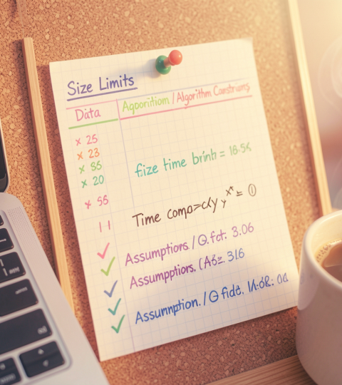
Constraints and Assumptions
List data size limits, time/memory bounds, and edge cases to handle.
State assumptions (e.g., sorted input, no duplicates) and target complexity (e.g., O(n log n) or O(n)).

Slide 6
Example Cases
Provide representative inputs with expected outputs.
Example 1: small array - single pass result.
Example 2: edge case (empty or max-size) - defined behavior and error handling.

Slide 7

03
Solution Approach

Slide 8
Algorithm Design
Choose core strategy: greedy, divide and conquer, or dynamic programming.
Outline steps, data structures, and key invariants. Emphasize correctness and minimal state.

Slide 9
Complexity Analysis
Estimate time and space in Big-O terms.
Highlight worst-case, average-case, and any trade-offs; state target like O(n) or O(n log n).

Slide 10

Implementation Steps
List concrete steps: parse input, validate, apply algorithm, format output.
Include testing hooks, edge-case checks, and brief comments for clarity.

Slide 11
Conclusions
Summarize approach, expected complexity, and validation strategy.
State next actions: optimize, test at scale, or prepare for integration.

Slide 12
Thanks!
Do you have any questions?
youremail@freepik.com
+34 654 321 432
yourwebsite.com
Please keep this slide for attribution

